Slide 1
Software Development for startups

Slide 2
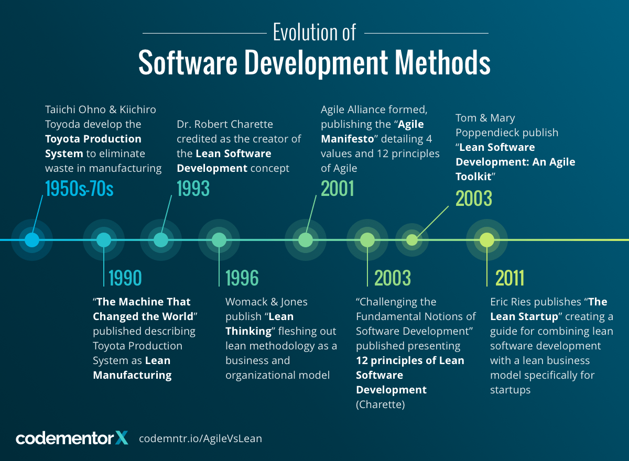

Slide 3
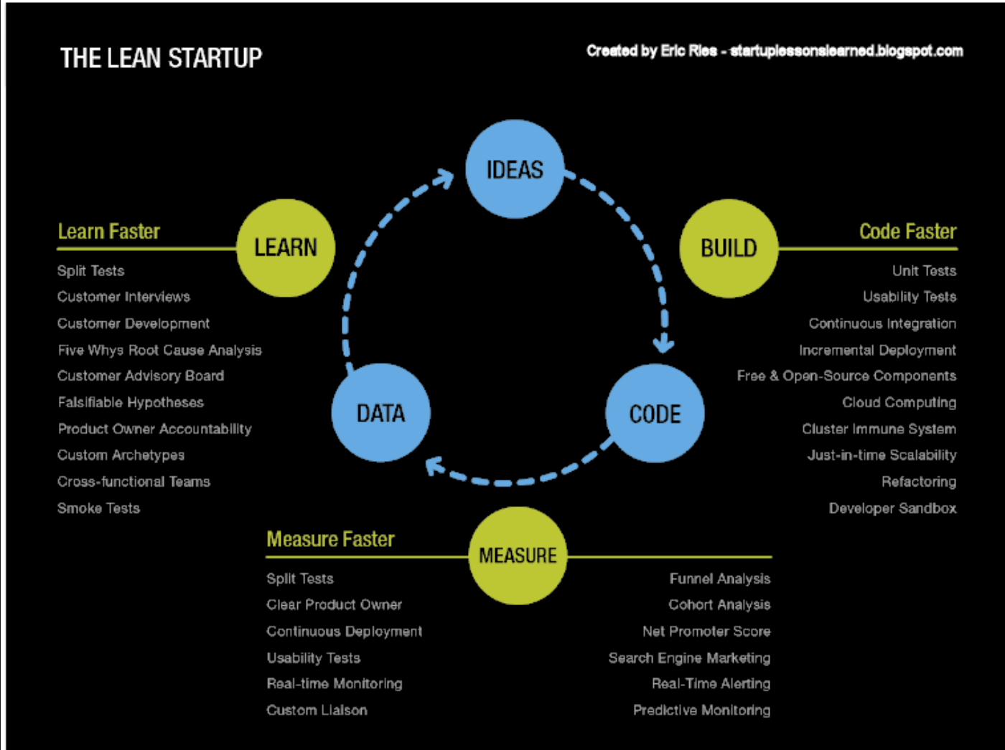

Slide 4
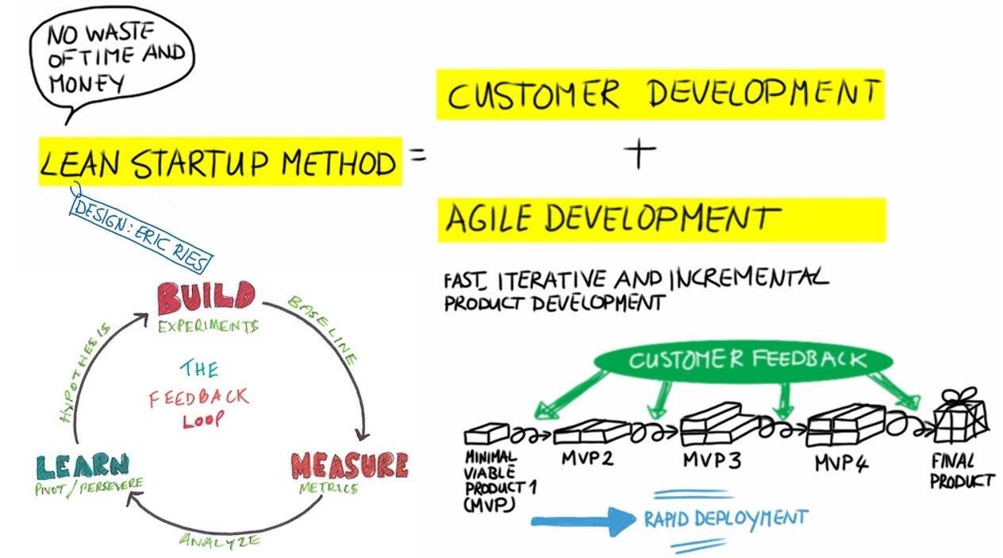
FUCK YOU SSAD

Slide 5
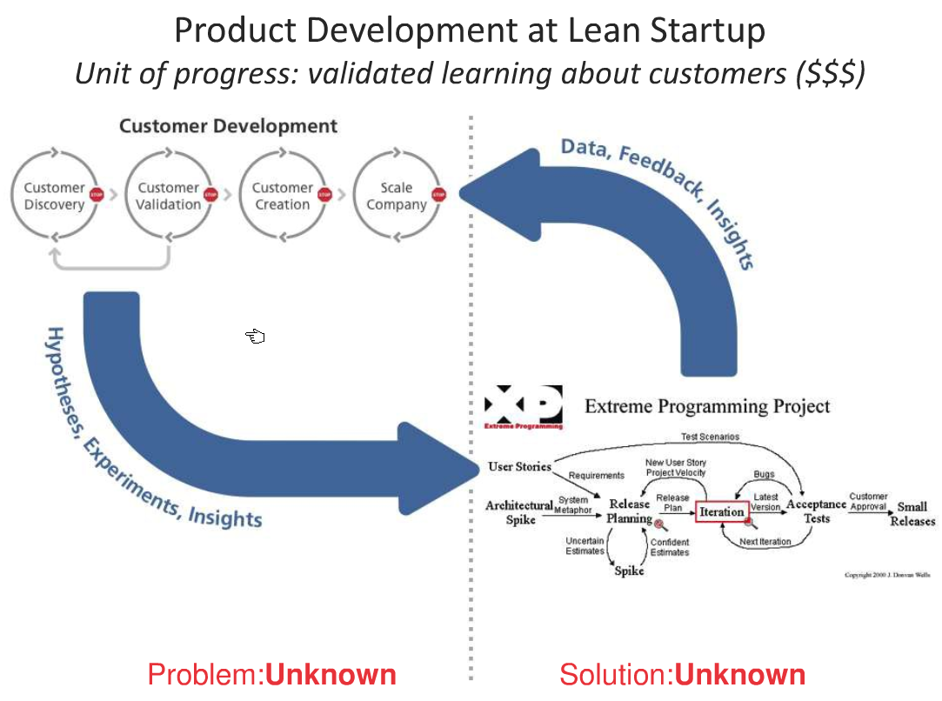
SoFuckingSAD

Slide 6
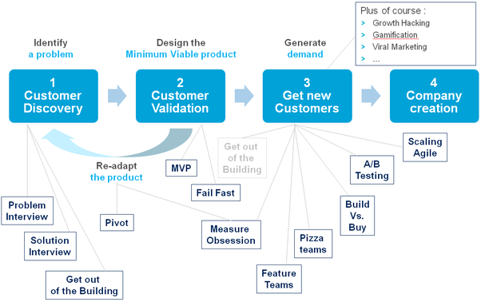
Some dev techniques

Slide 7
Class Assignment
4 sprint plan
For each sprint
Usecases in the sprint
Features in each sprint
Tasks
Tests
Integration sprint
Activities
Tests

